Slide 1

Exploiting modern architectures
Slide credit: some slides from Lucas Davi and others

Slide 2

Introduction
Critical vulnerabilities in modern processors
Read the kernel memory
Bypass security mechanism (ASLR)
Bypass sandboxing
Vulnerability originates in architecture
Difficult to fix!

Slide 3
Outline
First we will set the table
Ingredient 1: Side channel and covert channel attacks
Ingredient 2: Speculation and branch predictor
Meltdown and Spectre
Spectre (Branch target injection)
Spectre (Bypassing bound check)
Meltdown
What else is out there?
Possible defenses
Software defenses
New architectures

Slide 4

Ingredient 1: Covert/Side channels

Slide 5





Covert Channel
Malicious indirect communication of sensitive data.
^{Trojan}
^{Spy}
^{Covert Channel}
^{Gallery App}
^{Weather App}

Slide 6
Covert and side channels
Covert channel players: Trojan and spy
Trojan communicates with the spy covertly using the covert channel
Example: two prisoners communicating by banging on pipes
Side channel players: victim and spy
Spy attempting to figure out what victim is doing by observing side channel
Example: My students determining if I am here based on smell of coffee around my office
Key property: cooperation or not

Slide 7
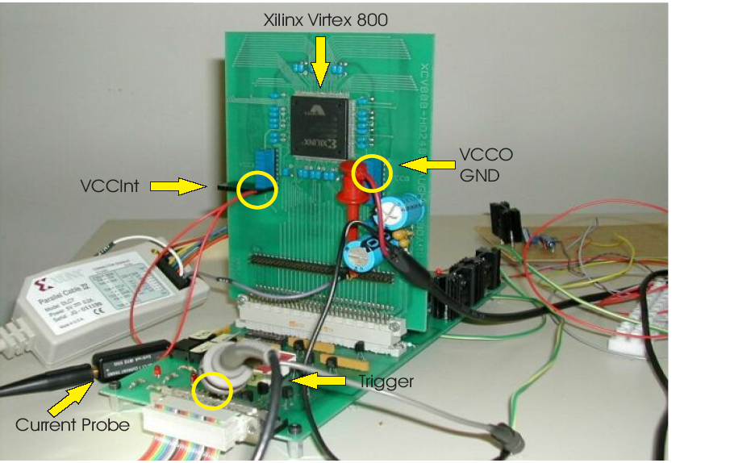
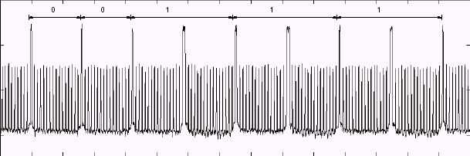
Power Analysis Attack
Idea: During switching CMOS gates draw spiked current
Trace of Current drawn - RSA Secret Key Computation
Only Squaring
Squaring and multiplication
Reported Results : Every Smartcard in the market BROKEN

Slide 8
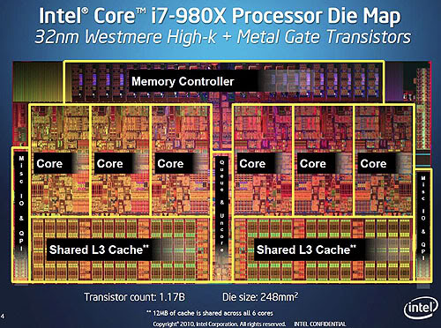
Microarchitecture side channels
Program security relies on isolation
Process boundary
Process vs. kernel
Sandboxing
Virtual machines, …
Modern processors support multiple programs running at the same time
Isolation broken at architecture level
Side channels galore!!
What one process does can affect others
What are examples?

Slide 9
Cache Side-Channel Attack
28 1e 4c 24
09 bf 15 82
30 6f 53 d9
a4 49 2d 0e
f2 85 5c 06
6a 91 4e 0c
c4 fc da a8
d5 37 e9 9c
SubBytes
S-Box
Set-associative cache
sets
ways

Slide 10
Flush+Reload Attack
CPU1
CPU2
Victim
Attacker
1- Flush each line in the critical data
2- Victim accesses critical data
3- Reload critical data (measure time)
L1-I
L1-D
L1-I
L1-D
L2
L2
Shared L3
Cache
Evicted
Time
sets
ways

Slide 11
Prime+Probe: L1 Attack
2-way SMT core
1- Prime each cache set
2- Victim accesses critical data
Victim
Attacker
3- Probe each cache set (measure time)
L1-I
L1-D
L2
L1 Cache
Evicted
Time
sets
ways

Slide 12
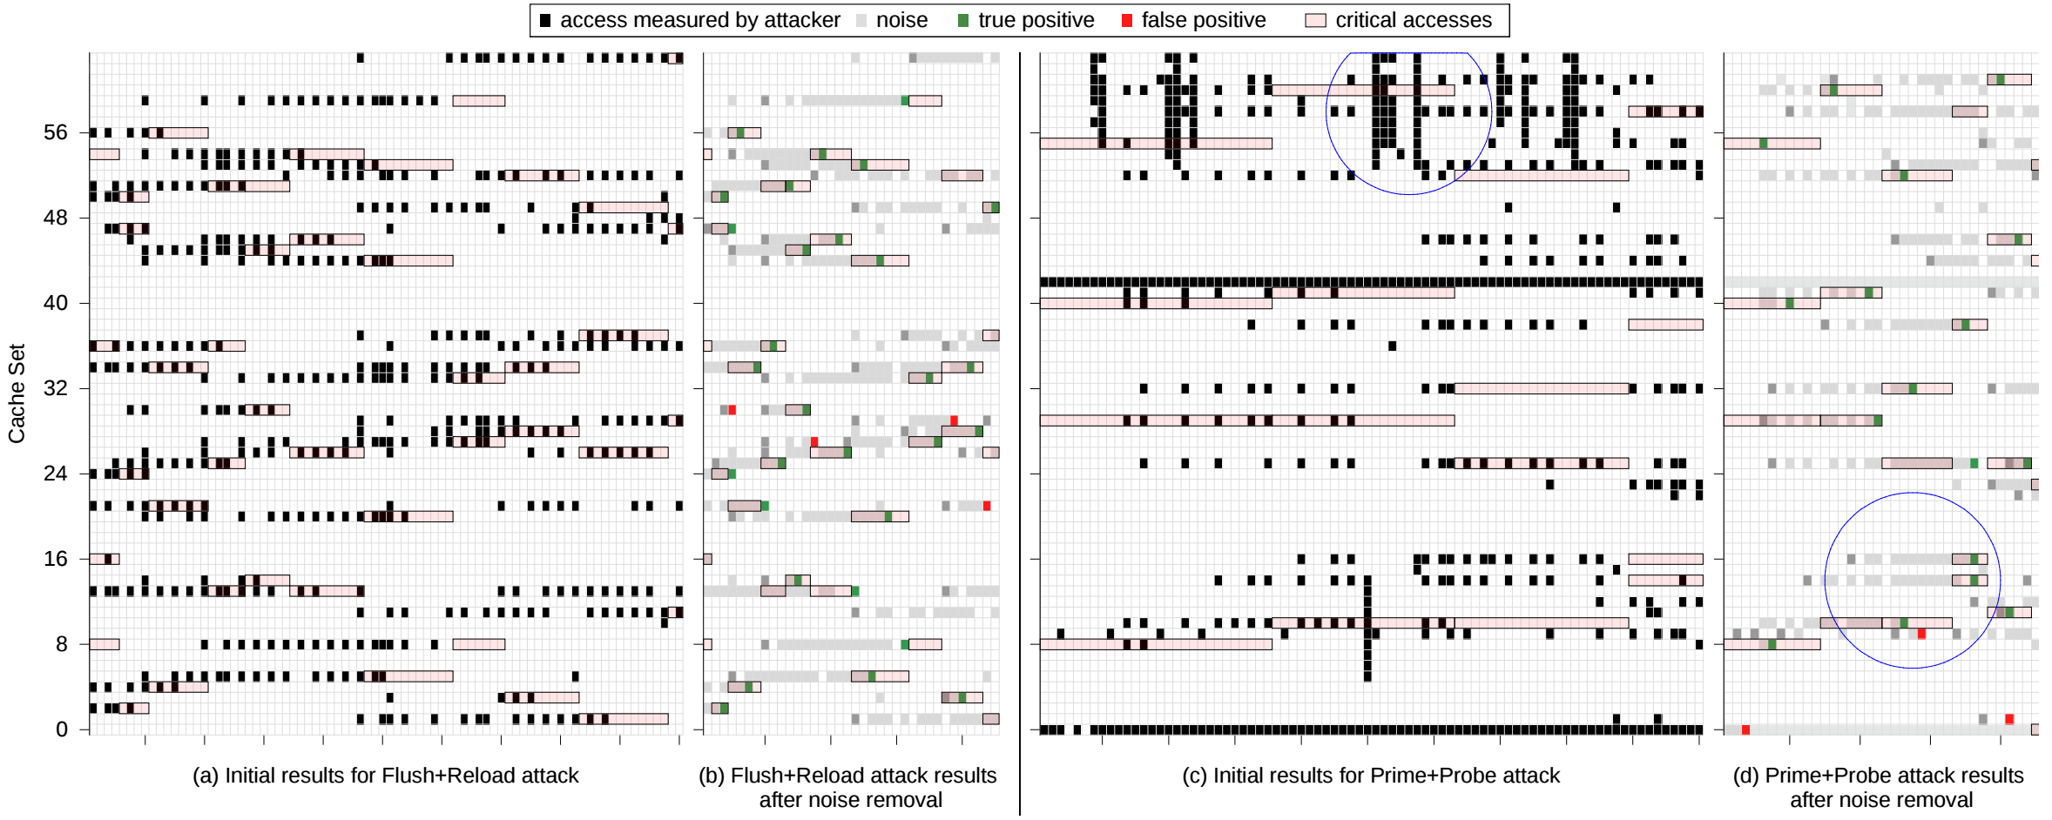
Attack on Critical Table

Slide 13
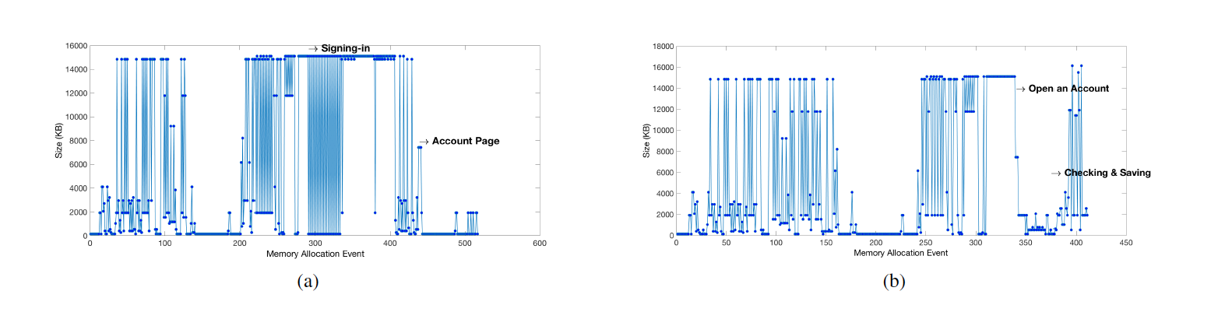
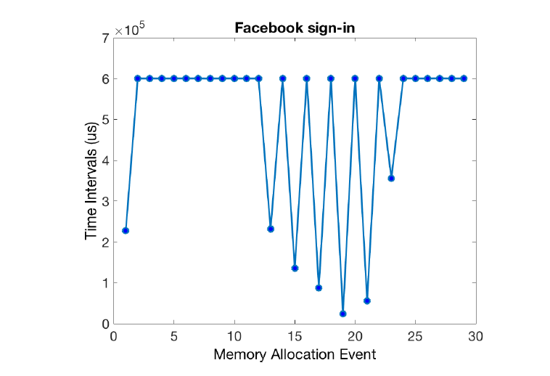
Side and covert channels are everywhere!
Paper under review– vulnerability reported to Nvidia

Slide 14

Ingredient 2: Speculative Execution

Slide 15
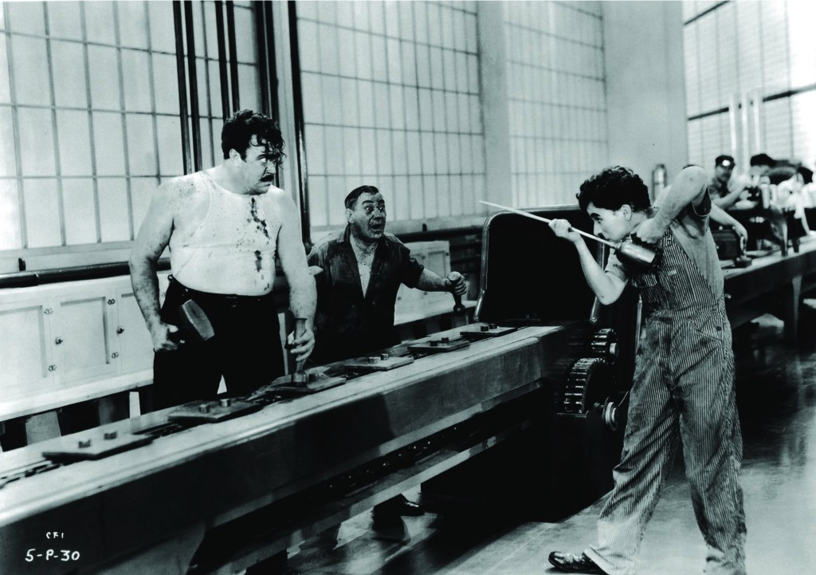
First lets start with pipelining
Reg
Write
Data
Memory
ALU
Reg
Read
Fetch
Notes:
Modern times – available on netflix

Slide 16
Control hazards!

Slide 17
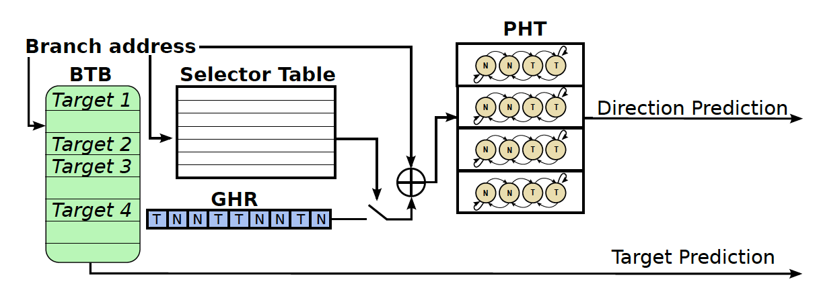
Enter branch predictors

Slide 18

Putting it all together– Attacks!

Slide 19
Some observations about speculation
Speculated instructions can be any old nonsense
We’ll clean up later
No checks of permissions.
Permissions not ready to check
No danger – we will squash instructions if wrong
Even security extensions do not work
Speculation causes exposure
Through side channels
Through physical exposure (e.g., memory bus)

Slide 20
General Idea of all attacks
Fool the processor to speculatively execute some instructions such that:
The instructions access sensitive data without permission
(basically a covert transmitter)
The data is exposed through a side channel
We read it from the side channel → broke isolation
Can read kernel memory; memory out of a sandbox; basically break software isolation based on permissions

Slide 21
Three published variants of attack
Spectre : bounds check bypass (CVE-2017-5753)
Spectre: branch target injection (CVE-2017-5715)
Meltdown: rogue data cache load (CVE-2017-5754)

Slide 22

Spectre: Variant 1 : bounds check bypass

Slide 23
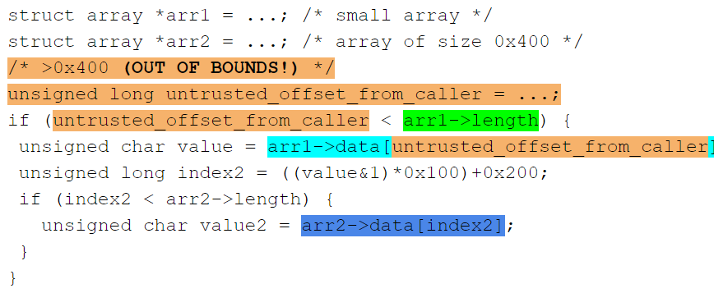
Variant 1: bypassing bound check
Read out of bound memory

Slide 24
Variant 1: bypassing bound check
Assumption:
These value are not cached:
arr1->length
arr2->data[0x200]
arr2->data[0x300]

Slide 25
Variant 1: bypassing bound check
Assumption:
The branch conditions are predicted as true
Speculatively:
load value = arr1->data[untrusted_offset_from_caller]
start a load from a data-dependent offset in arr2->data, loading the corresponding cache line into the L1 cache

Slide 26
Variant 1: bypassing bound check
measuring the time required to load arr2->data[0x200] andarr2->data[0x300]
Discloses whether arr1->data[untrusted_offset_from_caller]&1 is 0 or 1

Slide 27
Spectre: Variant 2 : branch target injection

Slide 28
Jump-over-ASLR: Attack Overview
Use Branch Target Buffer (BTB) to recover random address bits
Two scenarios:
One user space process attacking another
User process attacking Kernel ASLR
Attack capabilities:
Control speculation of another process
Recover all random bits in Linux Kernel and KVM*
Recover part of random bits in User Process making brute force attack much faster
* https://github.com/felixwilhelm/mario_baslr/

Slide 29
Branch Target Prediction Mechanism
Branch Target Buffer
Address tag | Target
jmp
A:
A
B
B:
Virtual Address space

Slide 30

User-Level Attack
Victim
Spy
Branch Target Buffer
Address tag | Target
jmp
jmp
A:
A:
A
B
B:
B:
C:
Observation: HIT
Observation: MISPREDICTION

Slide 31
Latencies Observed by the Spy on Haswell Processor

Slide 32
Variant 2: branch target injection background(Branch Target Buffer)
Branch Instruction
Address (Tag)
Branch PC
V
BIA
BTA
Branch Target
Address
Valid Bit
=
Next Fetch PC
Hit?

Slide 33

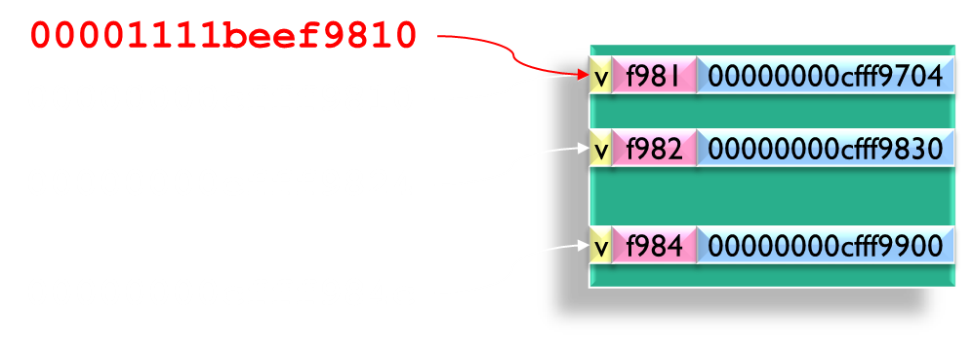
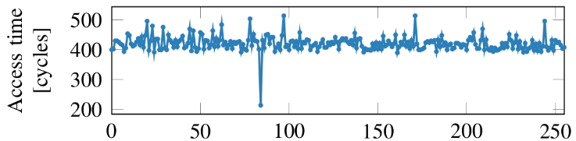
Big Picture
Data Area
1
Adversary knows the binary of the app
Code Area
Victim process
Adversary can inject address of ROP gadget into the BTB
2
Chosen
Payload
4
ROP payload leaks the data through side channel
3
CPU run the ROP payload speculatively

Slide 34

Meltdown: Variant 3: rogue data cache load

Slide 35
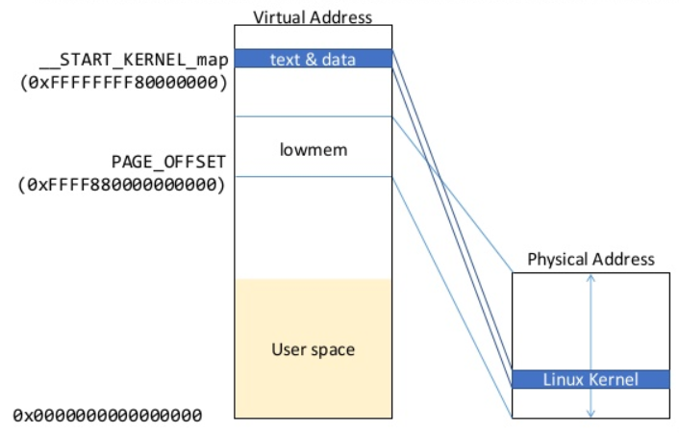
Variant 3: rogue data cache load background

Slide 36
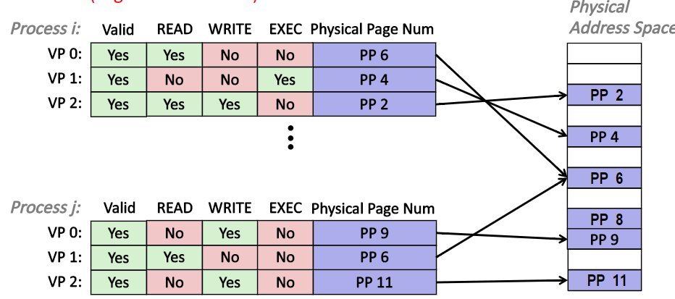
Variant 3: rogue data cache load background

Slide 37
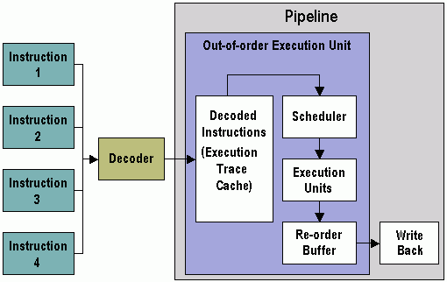
Variant 3: rogue data cache load background
Instruction decoder reads bytes from memory, parse the buffer and output instructions
Map architectural register to physical register
Insert instruction into reservation stations after renaming
Keep track of readiness of source values of an instruction

Slide 38
Variant 3: rogue data cache load background
When all source values of an instruction are ready, dispatch the instruction to functional unit (FU)
When a micro op is finished executing the result and exception status are added to the entry in the reorder buffer thus resolving dependencies of other micro ops

Slide 39
Variant 3: rogue data cache load background
An instruction updates the register alias table (essentially a future file for other instruction in the pipeline) when it completes execution
An instruction updates the architectural register file when it is the oldest in the machine(oldest in reorder buffer) and has completed execution

Slide 40
Variant 3: rogue data cache load explanation
Idea:
The permission check for accessing an address might not be on the critical path for reading data from memory to a register (permission check could have significant performance impact)
Memory read could make the result of the read available to following instructions immediately
Setting a flag in the reorder buffer that causes an exception to be raised if the permission check fails

Slide 41
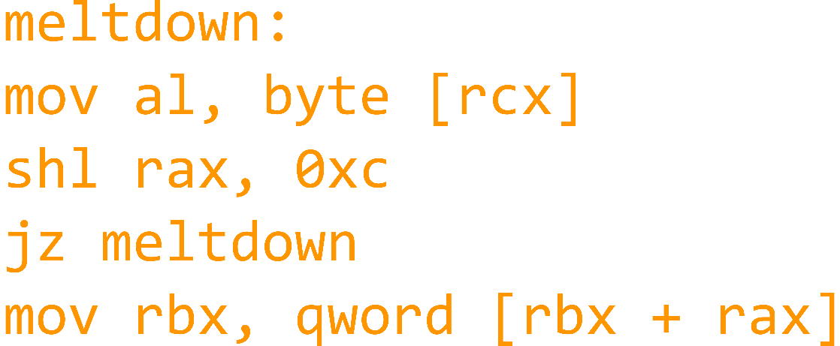
Variant 3: rogue data cache load explanation
Step 1 The content of an attacker-chosen memory location, which is inaccessible to the attacker, is loaded into a register.
Executes instructions in the small time window between the illegal memory access and the raising of the exception
1 rcx = kernel address
2 rbx = prob array
3
4
5
6
7
Notes:
The instruction sequence from step 1 which is executed out of order has to be chosen in a way that it becomes a transient instruction sequence. If this transient instruction sequence is executed before the MOV instruction is retired (i.e., raises the exception), and the transient instruction sequence performed computations based on the secret, it can be utilized to transmit the secret to the attacker

Slide 42
Variant 3: rogue data cache load explanation
Step 2 A transient instruction accesses a cache line based on the secret content of the register
(line 5-7)
1 rcx = kernel address
2 rbx = prob array
3
4
5
6
7
Notes:
The instruction sequence from step 1 which is executed out of order has to be chosen in a way that it becomes a transient instruction sequence. If this transient instruction sequence is executed before the MOV instruction is retired (i.e., raises the exception), and the transient instruction sequence performed computations based on the secret, it can be utilized to transmit the secret to the attacker

Slide 43
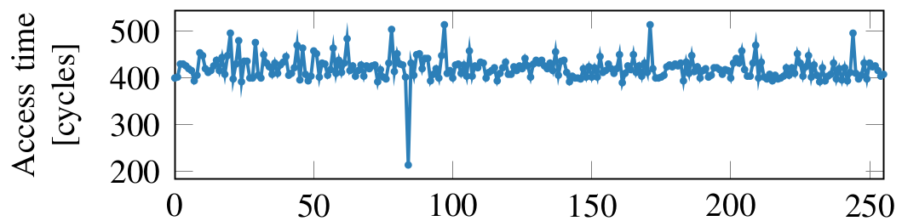
Variant 3: rogue data cache load explanation
1 rcx = kernel address
2 rbx = prob array
3
4
5
6
7
Step 3 The attacker uses Flush+Reload to determine the accessed cache line and hence the secret stored at the chosen memory location.
Notes:
The instruction sequence from step 1 which is executed out of order has to be chosen in a way that it becomes a transient instruction sequence. If this transient instruction sequence is executed before the MOV instruction is retired (i.e., raises the exception), and the transient instruction sequence performed computations based on the secret, it can be utilized to transmit the secret to the attacker

Slide 44

Defenses (short term/software)

Slide 45
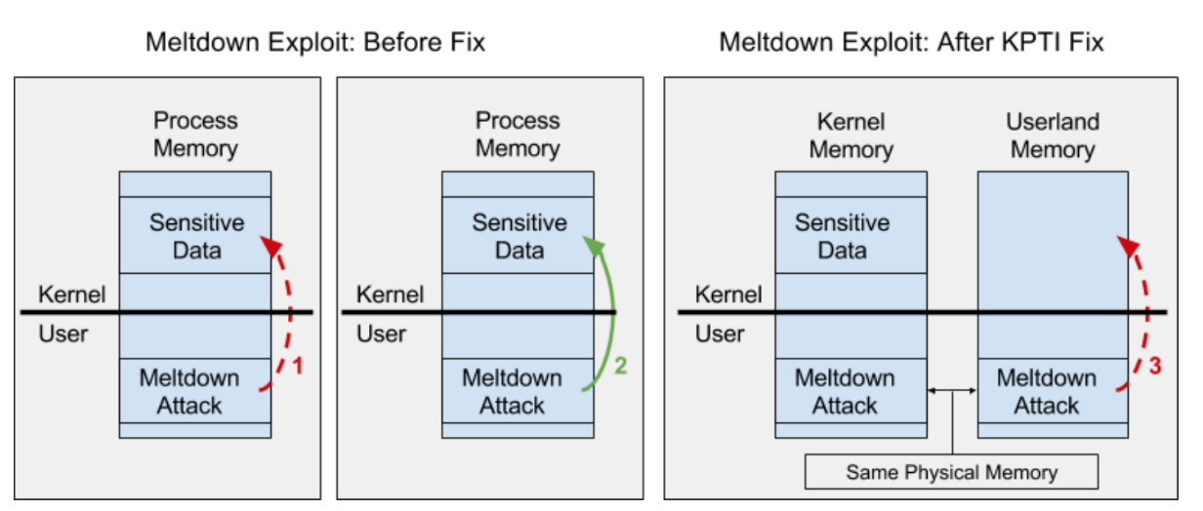
Kernel Page Table Isolation (KPTI)
Key Idea: Separate user space and kernel space
Each application has two sets of pages tables rather than one and switches between them on every kernel-to-user and user-to-kernel transition
Overhead on every system call, interrupt, etc..
Does not work for software sandboxes, or variant 2

Slide 46
Retpoline:(return + trampoline)
Retpoline:(return + trampoline)
Google’s defense against Spectre variant 2
Variant 2 is super dangerous for the cloud
Allows one application to disclose information of another
Uses another feature of modern processors called the Return Address Stack
Instead of predicting the return address through the branch target buffer, we keep the return value on a stack
When we retrun, we read it from the stack
Replace indirect branches with a return

Slide 47
Retpoline:(return + trampoline)
Subroutine Calls
Background:
P: 0x1000: (start of printf)
1
FFB
0x1000
A: 0xFC34: CALL printf
1
FC3
0x1000
B: 0xFD08: CALL printf
1
FD0
0x1000
C: 0xFFB0: CALL printf
BTB can easily predict target of calls

Slide 48
Retpoline:(return + trampoline)
Subroutine Returns
Background:
P: 0x1000: ST $RA → [$sp]
0x1B98: LD $tmp ← [$sp]
0x1B9C: RETN $tmp
0
A: 0xFC34: CALL printf
1
1B9
0xFC38
A’:0xFC38: CMP $ret, 0
X
B: 0xFD08: CALL printf
B’:0xFD0C: CMP $ret, 0
BTB can’t predict return for multiple call sites
BTB can easily predict target of calls

Slide 49
Retpoline:(return + trampoline)
Background: Return Address Stack (RAS)
Keep track of call stack
A: 0xFC34: CALL printf
FC38
FC38
P: 0x1000: ST $RA → [$sp]
…
BTB
D004
0x1B9C: RETN $tmp
A’:0xFC38: CMP $ret, 0
FC38

Slide 50
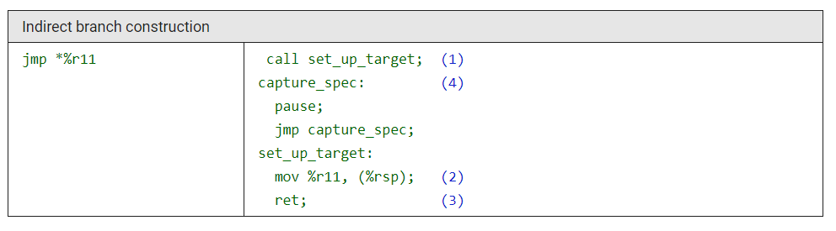
Variant 2: branch target injection Defenses: Retpoline
Retpoline:(return + trampoline)
Make a direct call to set_up_target.
Generates distinct stack and RSB entries with a return target of capture_spec.
Notes:
Make a direct call to set_up_target; this is known at compile time and will not trigger speculative target resolution. This generates distinct stack and RSB entries with a return target of capture_spec.

Slide 51
Variant 2: branch target injection Defenses: Retpoline
Retpoline:(return + trampoline)
2. Modify the on-stack entry generated by (1), to instead direct to %r11.
Notes:
Make a direct call to set_up_target; this is known at compile time and will not trigger speculative target resolution. This generates distinct stack and RSB entries with a return target of capture_spec.

Slide 52
Variant 2: branch target injection Defenses: Retpoline
Retpoline:(return + trampoline)
3. Return against our original call
Speculative execution consumes the RSB entry generated by (1), and is captured within the pause loop at (4). These instructions are only executed by the speculative path.
Our return is ultimately retired, the on-stack value is used to locate the actual new instruction pointer and the benign results of any speculative execution in the loop at (4) are discarded
Notes:
Make a direct call to set_up_target; this is known at compile time and will not trigger speculative target resolution. This generates distinct stack and RSB entries with a return target of capture_spec.

Slide 53

Thinking ahead – what is next?

Slide 54
Things that make you go hmmm…
Speculation is very old
Architectures have been vulnerable for over 30 years
But then only discovered now? Why?
Suspected for a long time; 1992 paper
Discovered concurrently by at least 4 teams!
“things we don’t know we don’t know” – Donald Rumsfled ☺
Offensive security research is important
Sometimes not considered seriously
What else is out there?
How can we fix it?

Slide 55
New Attacks
Unfortunately, many more variants are appearing
New side channels: attacks through the L1 cache, and the TLBs
New applications: Other attacks demonstrated on SGX
Branchscope? Attack on the directional part of the branch predictor
Not public yet – reported to Intel
SpectrePrime and MeltdownPrime
New attacks from Princeton/Nvidia using the cache coherence/memory consistency protocol

Slide 56
Principled/comprehensive solutions
One proposal – disable speculation
Use parallelism instead
Ugh…back to the dark ages of computer architecture
Keep speculation, but make it safe
New ways of designing architectures
SafeSpec (our proposal)
Poison Ivy (Micro 2016)
Safe branch predictors:
Decorrelated/private branch predictors
Control Flow Integrity based branch predictors

Slide 57
Conclusions/Summary
Security traditionally considered a software problem to be solved in software
…but we see that architectures can be a source of vulnerability
Architectures must be designed with security in mind
…but they can also offer security mechanisms for software
Meltdown/Spectre will force a seismic rethinking of how to design architectures
Will be played out over the next few years…

Slide 58

Questions?

